Slide 1
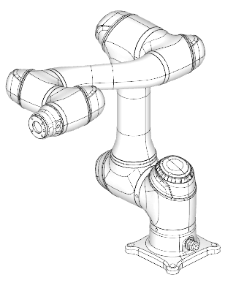
Task-space operation of COBOT End-effecter

Slide 2
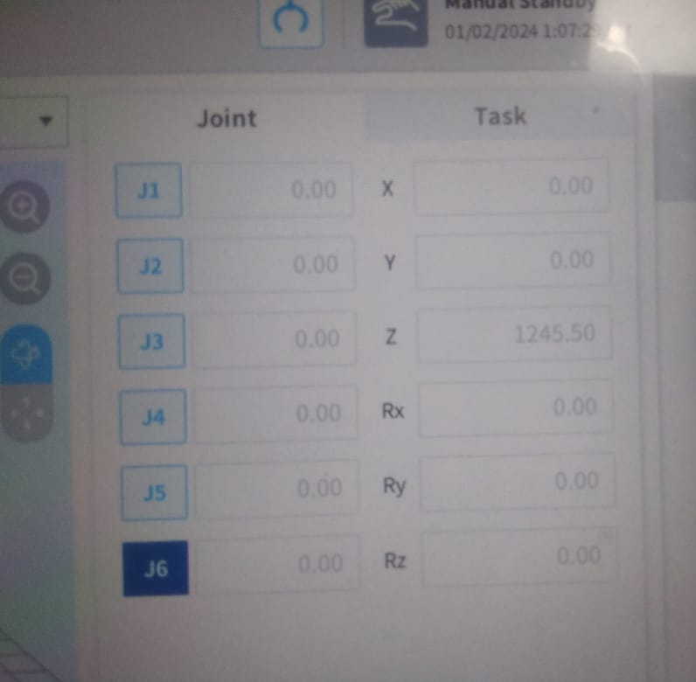
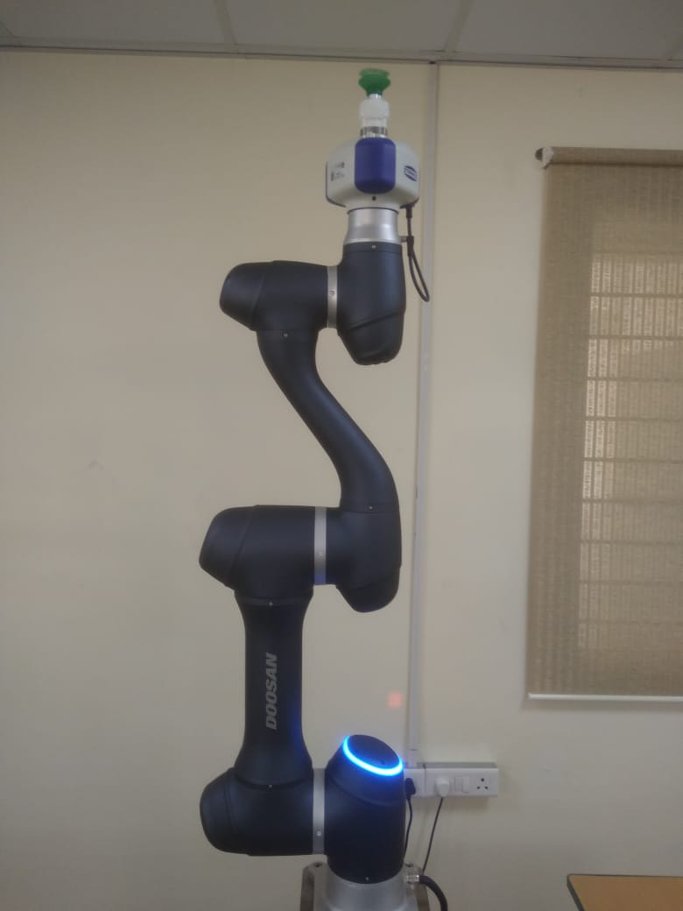
Home configuration
Z
{6}
X
Y
190
124
367
1245.5
900
409
Z
{0}
X
155.5
Y

Slide 3
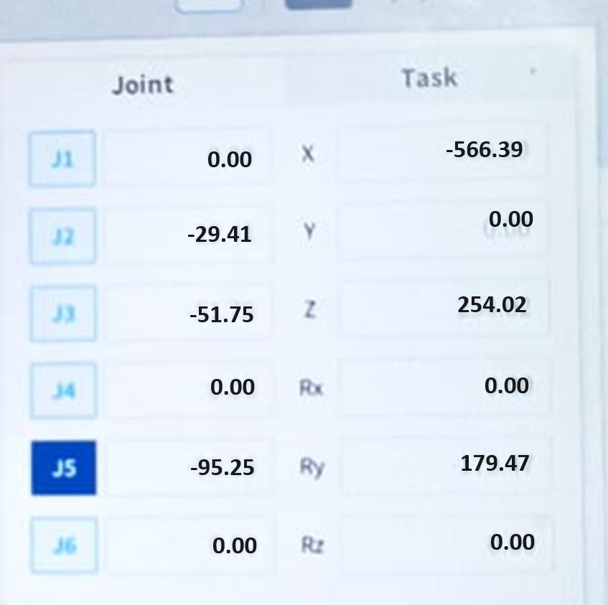
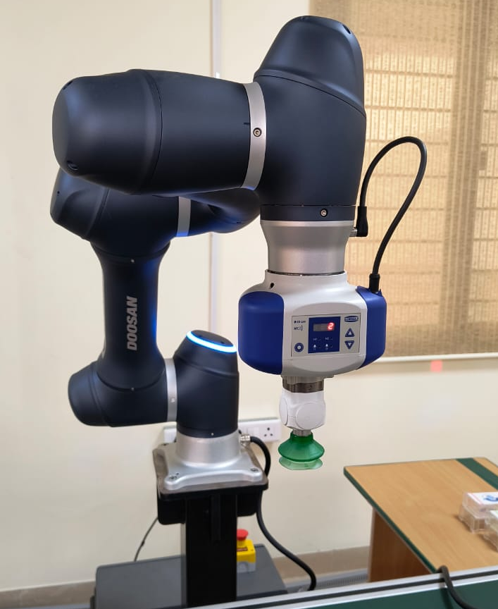
Bringing COBOT to a Configuration before doing task-space operation

Slide 4

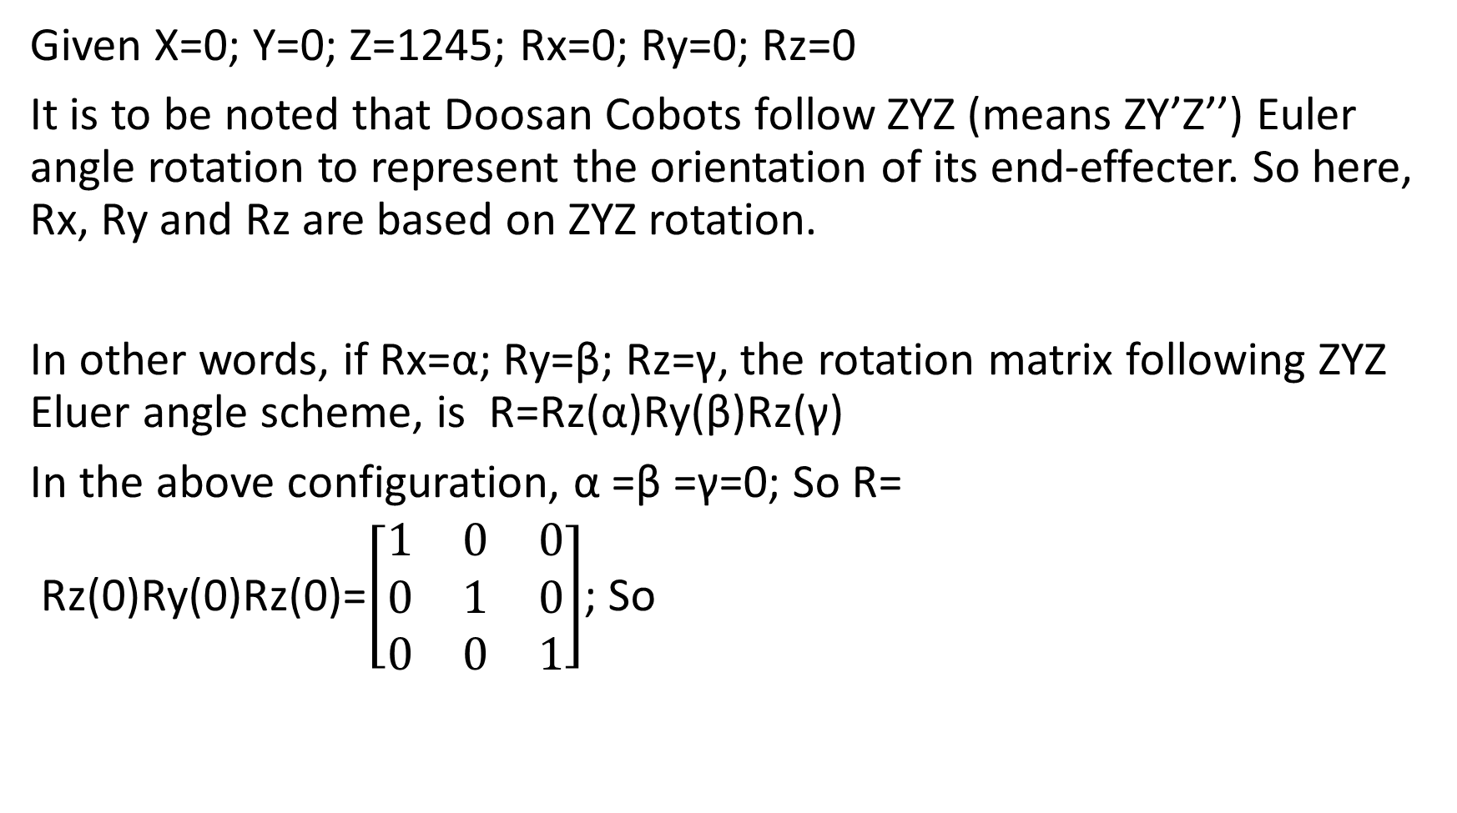
Determination of ⁰T₆
Given X=0; Y=0; Z=1245; Rx=0; Ry=0; Rz=0
It is to be noted that Doosan Cobots follow ZYZ (means ZY’Z’’) Euler angle rotation to represent the orientation of its end-effecter. So here, Rx, Ry and Rz are based on ZYZ rotation.
In other words, if Rx=α; Ry=β; Rz=γ, the rotation matrix following ZYZ Eluer angle scheme, is R=Rz(α)Ry(β)Rz(γ)
In the above configuration, α =β =γ=0; So R=
Rz(0)Ry(0)Rz(0)=$\left[\begin{matrix}1 & 0 & 0 \\ 0 & 1 & 0 \\ 0 & 0 & 1\end{matrix}\right]$; So

Slide 5
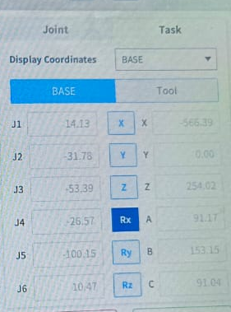
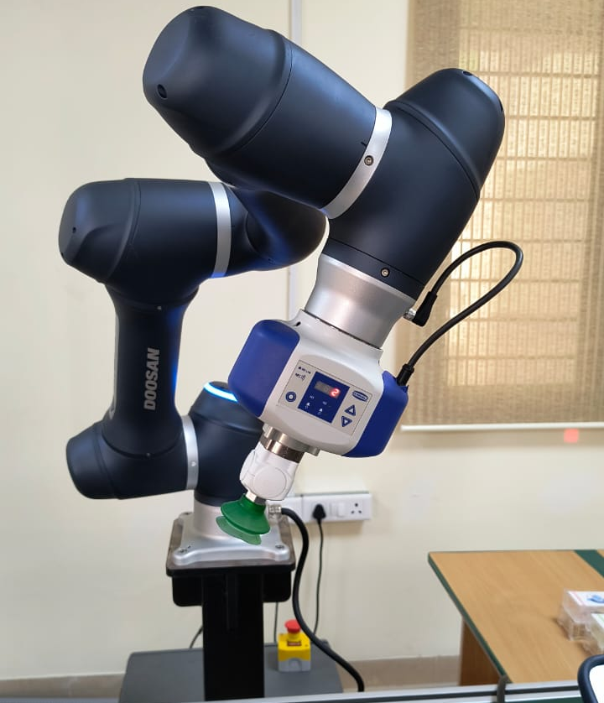

Slide 6
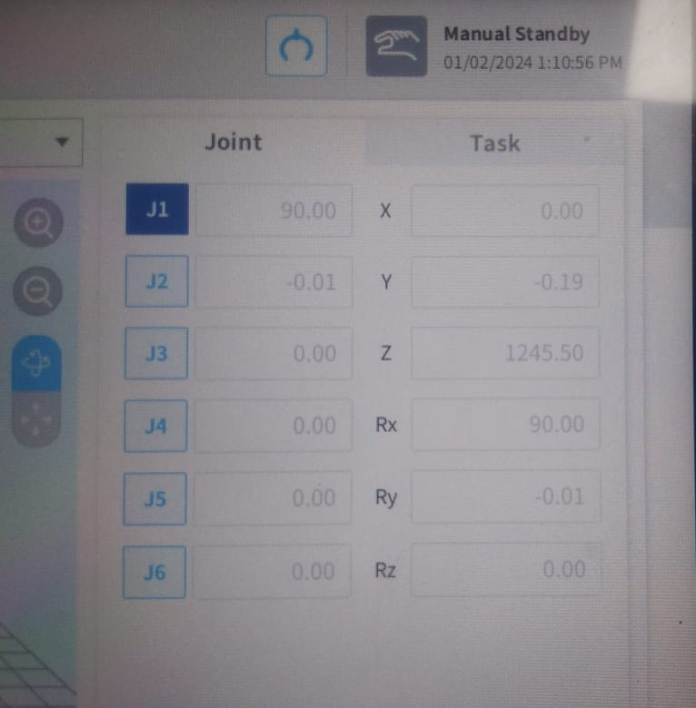
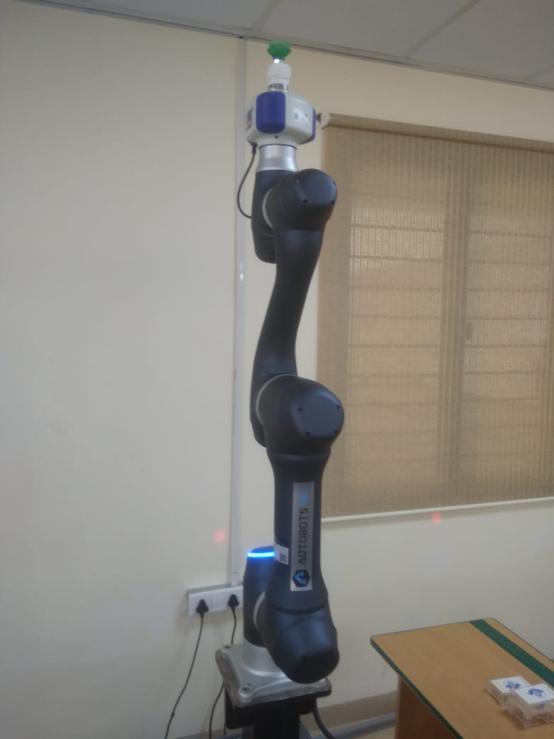
90º rotation of J1
Z
{6}
X
Y
{0}
X
Z
J1
Y

Slide 7

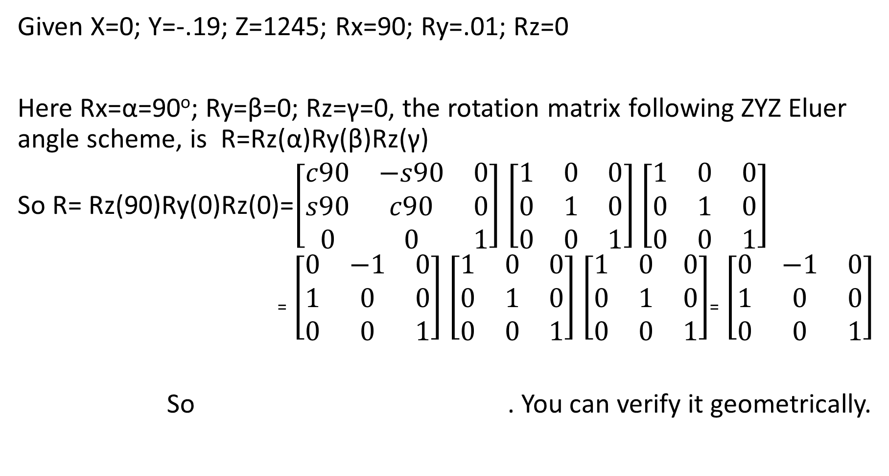
Determination of ⁰T₆
Given X=0; Y=-.19; Z=1245; Rx=90; Ry=.01; Rz=0
Here Rx=α=90º; Ry=β=0; Rz=γ=0, the rotation matrix following ZYZ Eluer angle scheme, is R=Rz(α)Ry(β)Rz(γ)
So R= Rz(90)Ry(0)Rz(0)=$\left[\begin{matrix}c90 & −s90 & 0 \\ s90 & c90 & 0 \\ 0 & 0 & 1\end{matrix}\right]$ $\left[\begin{matrix}1 & 0 & 0 \\ 0 & 1 & 0 \\ 0 & 0 & 1\end{matrix}\right]$ $\left[\begin{matrix}1 & 0 & 0 \\ 0 & 1 & 0 \\ 0 & 0 & 1\end{matrix}\right]$
₌ $\left[\begin{matrix}0 & −1 & 0 \\ 1 & 0 & 0 \\ 0 & 0 & 1\end{matrix}\right]$ $\left[\begin{matrix}1 & 0 & 0 \\ 0 & 1 & 0 \\ 0 & 0 & 1\end{matrix}\right]$ $\left[\begin{matrix}1 & 0 & 0 \\ 0 & 1 & 0 \\ 0 & 0 & 1\end{matrix}\right]$₌ $\left[\begin{matrix}0 & −1 & 0 \\ 1 & 0 & 0 \\ 0 & 0 & 1\end{matrix}\right]$
So . You can verify it geometrically.

Slide 8
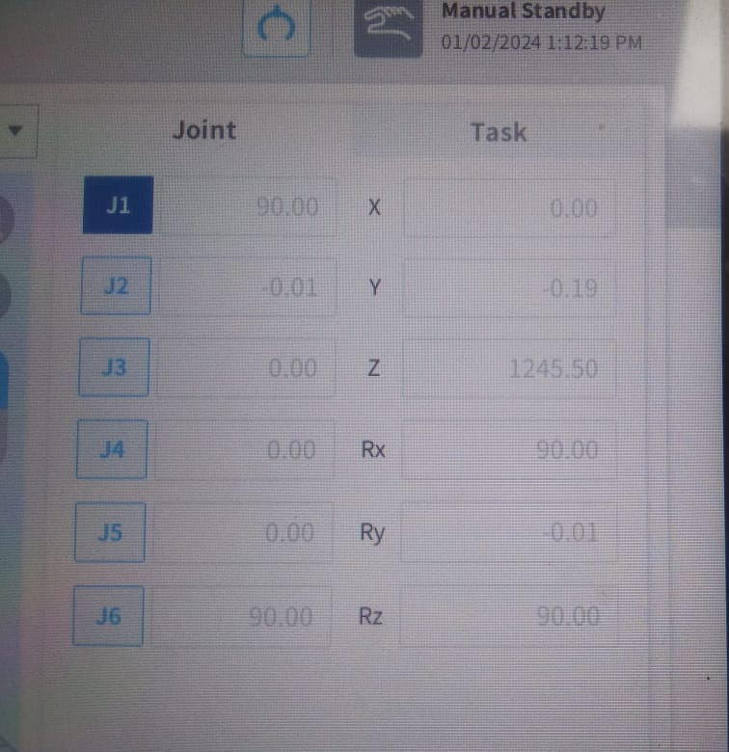
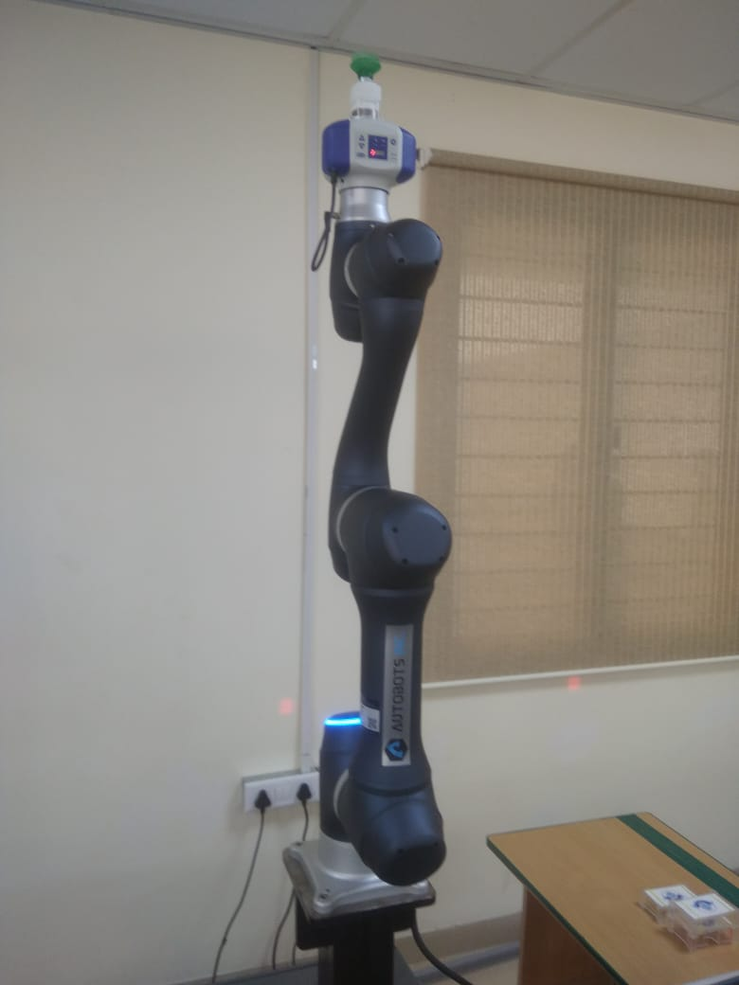
90º rotation of J6
Z
{6}
Y
X
J5
J6
J4
J3
{0}
X
Z
J1
Y
J2

Slide 9

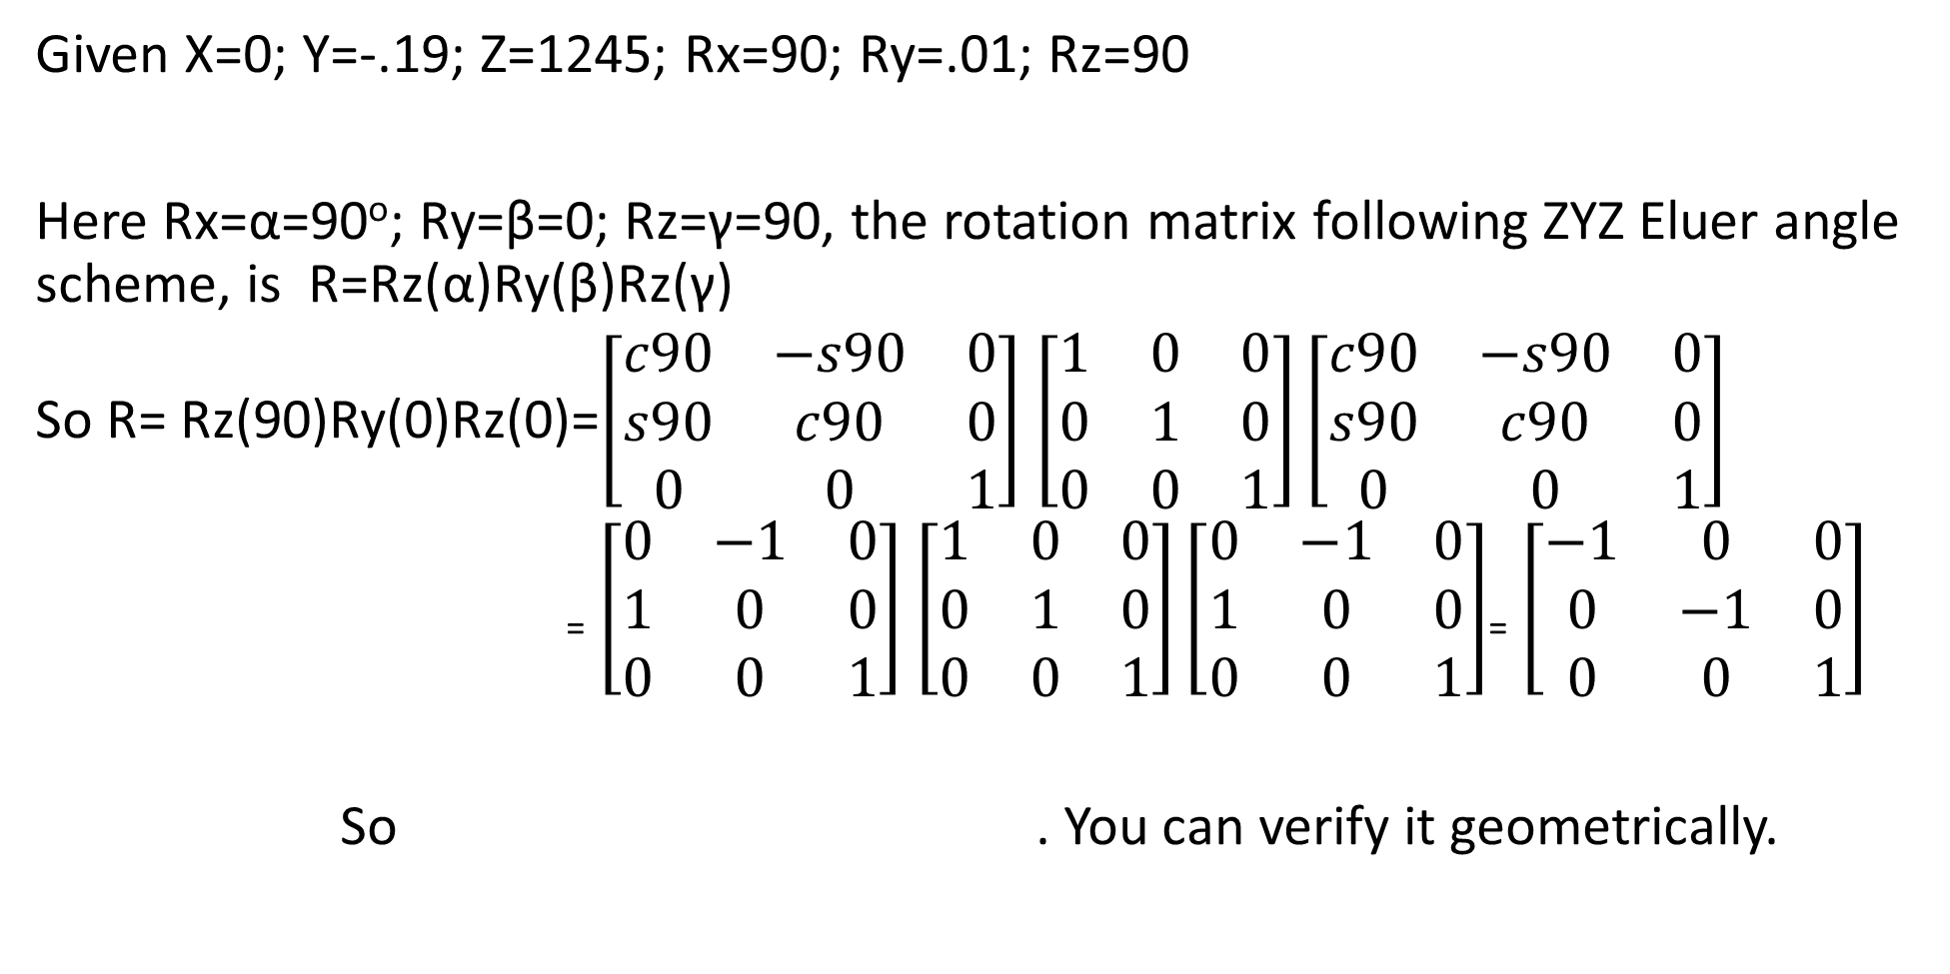
Determination of ⁰T₆
Given X=0; Y=-.19; Z=1245; Rx=90; Ry=.01; Rz=90
Here Rx=α=90º; Ry=β=0; Rz=γ=90, the rotation matrix following ZYZ Eluer angle scheme, is R=Rz(α)Ry(β)Rz(γ)
So R= Rz(90)Ry(0)Rz(0)=$\left[\begin{matrix}c90 & −s90 & 0 \\ s90 & c90 & 0 \\ 0 & 0 & 1\end{matrix}\right]$ $\left[\begin{matrix}1 & 0 & 0 \\ 0 & 1 & 0 \\ 0 & 0 & 1\end{matrix}\right]\left[\begin{matrix}c90 & −s90 & 0 \\ s90 & c90 & 0 \\ 0 & 0 & 1\end{matrix}\right]$
₌ $\left[\begin{matrix}0 & −1 & 0 \\ 1 & 0 & 0 \\ 0 & 0 & 1\end{matrix}\right]$ $\left[\begin{matrix}1 & 0 & 0 \\ 0 & 1 & 0 \\ 0 & 0 & 1\end{matrix}\right]\left[\begin{matrix}0 & −1 & 0 \\ 1 & 0 & 0 \\ 0 & 0 & 1\end{matrix}\right]$₌ $\left[\begin{matrix}−1 & 0 & 0 \\ 0 & −1 & 0 \\ 0 & 0 & 1\end{matrix}\right]$
So . You can verify it geometrically.

Slide 10
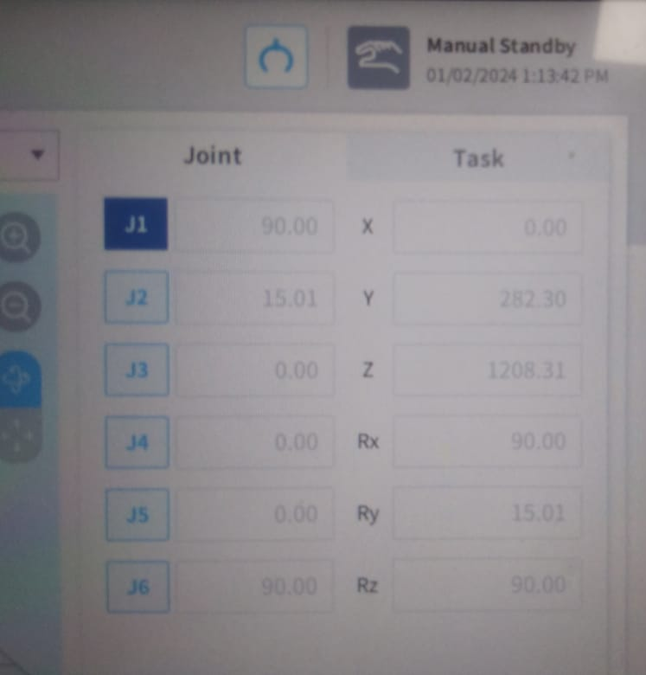
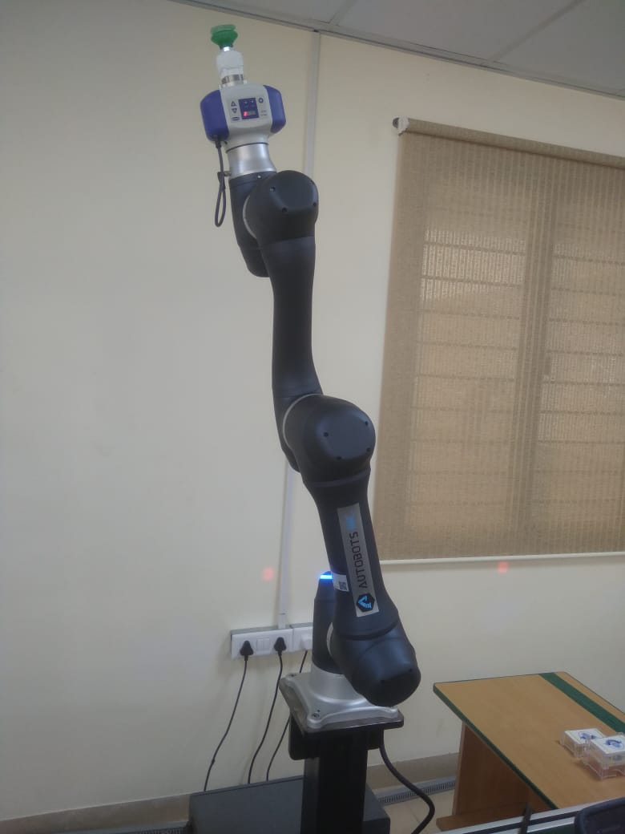
15º rotation of J2
Z
{6}
Y
X
{0}
X
Z
Y

Slide 11
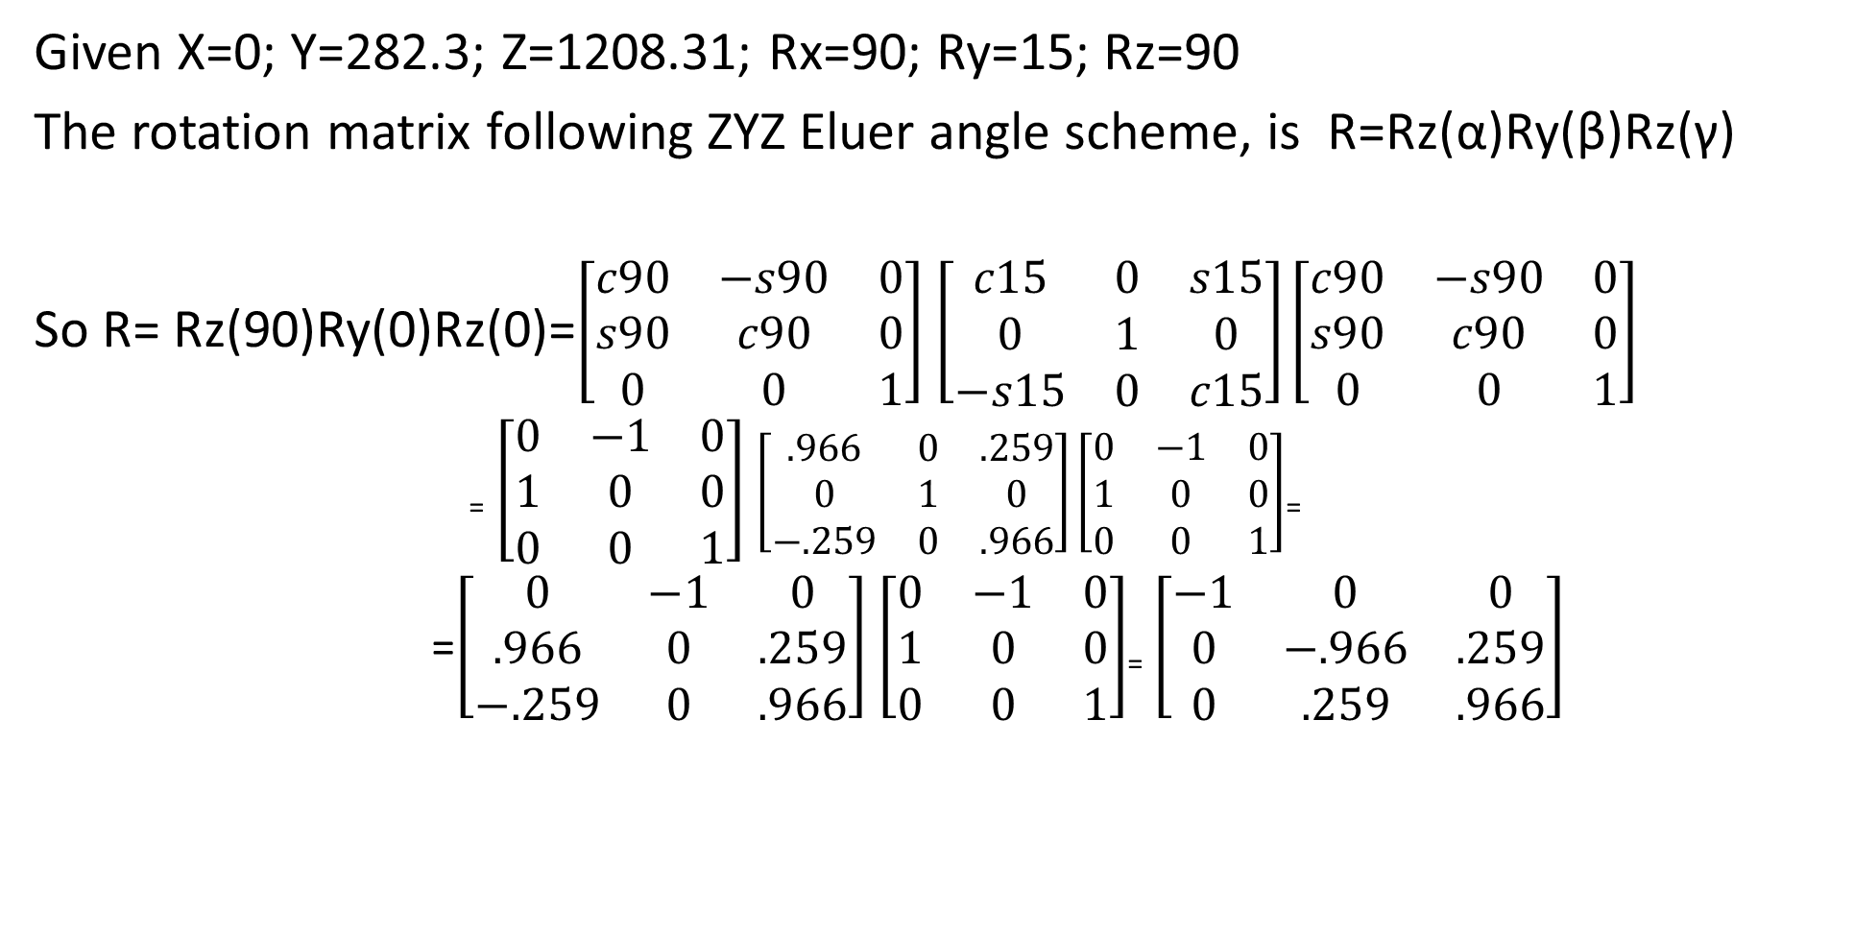
Determination of ⁰T₆
Given X=0; Y=282.3; Z=1208.31; Rx=90; Ry=15; Rz=90
The rotation matrix following ZYZ Eluer angle scheme, is R=Rz(α)Ry(β)Rz(γ)
So R= Rz(90)Ry(0)Rz(0)=$\left[\begin{matrix}c90 & −s90 & 0 \\ s90 & c90 & 0 \\ 0 & 0 & 1\end{matrix}\right]$ $\left[\begin{matrix}c15 & 0 & s15 \\ 0 & 1 & 0 \\ −s15 & 0 & c15\end{matrix}\right]\left[\begin{matrix}c90 & −s90 & 0 \\ s90 & c90 & 0 \\ 0 & 0 & 1\end{matrix}\right]$
₌ $\left[\begin{matrix}0 & −1 & 0 \\ 1 & 0 & 0 \\ 0 & 0 & 1\end{matrix}\right]$ $\left[\begin{matrix}.966 & 0 & .259 \\ 0 & 1 & 0 \\ −.259 & 0 & .966\end{matrix}\right]\left[\begin{matrix}0 & −1 & 0 \\ 1 & 0 & 0 \\ 0 & 0 & 1\end{matrix}\right]$₌
=$\left[\begin{matrix}0 & −1 & 0 \\ .966 & 0 & .259 \\ −.259 & 0 & .966\end{matrix}\right]$ $\left[\begin{matrix}0 & −1 & 0 \\ 1 & 0 & 0 \\ 0 & 0 & 1\end{matrix}\right]$₌ $\left[\begin{matrix}−1 & 0 & 0 \\ 0 & −.966 & .259 \\ 0 & .259 & .966\end{matrix}\right]$

Slide 12

Z
Y
{6}
X
So new Z= 155.5 + 1090 cos15º= 1208.35
New Y=1090 Sin 15º=282.11
No change in X
So
1090
{0}
X
Z
15º
Y
155.5

